Slide 1

Cascading Style Sheets (CSS)
1

Slide 2
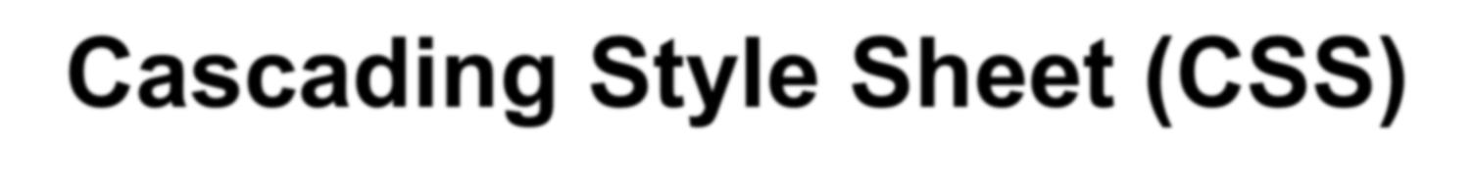
Cascading Style Sheet (CSS)
Recommended by W3C
The Characteristics of CSS
  The layout of the page can be flexibly
    It can specify the font name and size precisely
    It can specify margin and indent
    It can specify the position of the text and image
  The page and web layout can be managed collectively
    The changes can be done easily
To validate your style sheet
  http://jigsaw.w3.org/css-validator/validator-uri.html

Slide 3

Implementation of CSS
Methods of Implementation
  Following are the 4 methods of implementing the css.
    Inline Style sheet (Specify style directly by using the style attributes)
    Embedded style sheet (Define style in advance to STYLE element, then apply
    Linking style sheet (By using LINK elements link the external file where style has
been defined
    Import style sheet (By using STYLE element, specify the external file (define
style) to be imported

Slide 4

Case by case example
When you want to specify style only at this position
Specify style directly with
[Inline style sheet]
When you want to specify the
common style only on this page
Define and apply style with
[Embedded style sheet]
When you want to specify the common style on all the pages
Define and apply style in
4 external file [Linking/Import]

Slide 5
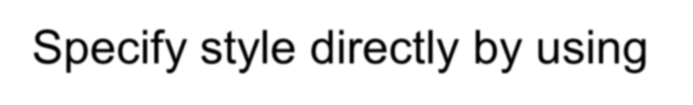

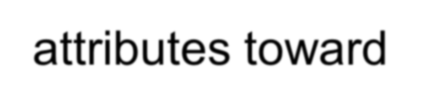

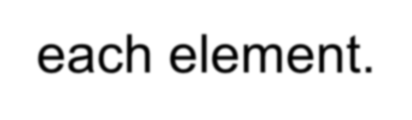
Inline Style Sheet
Specify style directly by using STYLE attributes toward each element.
<BODY>
<Tag STYLE=“property:value”> - </Tag>
</BODY>
<BODY>
<H1 STYLE=“color: red”>Red heading 1 </H1>
<P STYLE=“color: blue; FONT-size:20px”> Blue Paragraph</P>
Separator
</BODY>
Use for each element within the BODY
At STYLE attribute, specify the style to use
Multiple styles can be defined, separated with semi-colon.
The are where the style is applied is different depending on the element
5

Slide 6
Embedded Style Sheet
Define the style within the HEAD, then apply the style in the BODY, style is defined with the form of [Rule]
<HEAD>
<STYLE TYPE=“TEXT/CSS”>
</STYLE>
<HEAD>
Selector {Property:value}
<HEAD>
<STYLE TYPE=“TEXT/CSS”>
H1{color:red; font-size:20px}
</STYLE>
</HEAD>
<BODY>
<H1>Heading</H1>
</BODY>
Selector: Tie up the HTML
element and style defined by definition part
Property: Specify the property
toward the specified element in selector
Definition
Applied
Value: Specify the applied value
₆ to the style

Slide 7
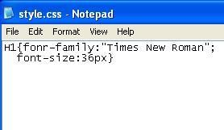
Linking Style Sheet
Link the style and the external file which defines the style within the HEAD.
File Extension is .CSS
<HEAD>
<LINK REL=“stylesheet” TYPE=“text/css” HREF=“url”>
</HEAD>
<HEAD>
<TITLE>title</TITLE>
<LINK REL=“stylesheet” TYPE=“text/css” HREF=“style.css”>
</HEAD>
<BODY>
<H1>Heading</H1>
Style file defining style
</BODY>
7

Slide 8
Linking Style Sheet …
In REL attribute, specify the relationship with the file linked.
In TYPE attribute, specify the MIME type of style file
In HREF attribute, specify the style file location and name. (file extension is .css)
Both absolute path and relative path can be specified for the style file name
Define only the [rules] in style file
Applied in BODY part
8

Slide 9
Import Style Sheet
Import the external file where the style has been defined in HEAD part.
<HEAD>
<STYLE TYPE=“TEXT/CSS”>
@import url (file name or URL);
</STYLE>
</HEAD>
9

Slide 10
The Priority among 4 Implementation Methods
When multiple styles are specified in the document, the following priority order shall be applied.
Style sheet by external files (Linking/Import)
Embedded Style
sheet
Inline Style sheet
Define the general style of the Web by [Style sheet by external files]
Define the style of whole page by [Embedded style sheet]
Define individual style by [Inline style sheet]
10

Slide 11
The Selector
If a element is used in selector, then all style are applied in that element.
Styles can be specified in details using the following 5 methods.
  Element Selector
    Always specify common style toward the element
  Class Selector
    Create and define optional name to the specify style, then apply it.
  ID Selector
    Create and define the optional name towards the specify style, and apply it at one place in a document
  Group Selector
    Apply the common style to multiple elements
  Context Selector
    Apply style only specified part where multiple elements are all specified.
11

Slide 12
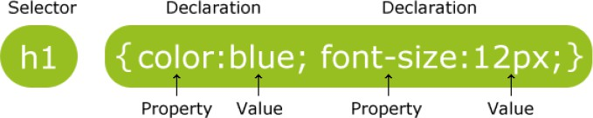
1. Element Selector
The common style can be applied to an element at all time
In Selector, specify the element name to apply the style
<HEAD>
<STYLE TYPE=“text/css”>
Element {Property:Value}
</STYLE>
</HEAD>
<HEAD>
<STYLE TYPE=“text/css”> H1{color:red} H2{color:blue}
</STYLE>
</HEAD>
<BODY>
<H1>Heading 1</H1>
<H2>Item 1</H2>
Definition / declaration
Applied
<H1>Heading 2</H1>
<H2>Item 2</H2>
<¹/²BODY>

Slide 13

2. Class Selector
In TYPE attribute, specify the MIME type of the style definition part.
Class name starts with a period (.)
In Selector, specify the name created for the define style
When applying the CLASS, remove the period (.)
<HEAD>
<STYLE TYPE=“text/css”>
.Class name {Property:Value}
</STYLE>
<HEAD>
<STYLE TYPE=“text/css”>
.red{color:#FF0000}
.blue{color:#0000FF}
</STYLE>
</HEAD>
<BODY>
<H1 CLASS=“red”>Heading 1</H1>
<H2 CLASS=“blue”>Item 1</H2>
</HEAD>
Define
Applied
<H1>Heading 2</H1>
<P CLASS=“red”> Paragraph </P>
Do not Apply Applied
13
</BODY>

Slide 14
3. ID Selector
Define and name a specific style, and apply it by specifying the name.
However it cannot be called twice but some browsers can use it like the
class selector for more than twice (using function)
<HEAD>
<STYLE TYPE=“text/css”>
#ID {Property:Value}
</STYLE>
</HEAD>
<HEAD>
<STYLE TYPE=“text/css”>
#id123{color:red}
Define
</STYLE>
</HEAD>
<BODY>
When ID is specified, the “sharp”
will be removed
<H1 ID=“id123”>Heading 1</H1>
<P>Content 1</P>
Applied
<₁₄/BODY>

Slide 15
4. Grouped Selector
By grouping multiple elements, separated with comma (,), common style can be applied.
<HEAD>
<STYLE TYPE=“text/css”>
Element 1, Element 2,…. {Property:Value}
</STYLE>
</HEAD>
<HEAD>
<STYLE TYPE=“text/css”>
H1,H2,H3 {font:24px;
color:blue}
</STYLE>
</HEAD>
<BODY>
<H1>Heading 1</H1>
<H2>Heading 1</H2>
<H3>Heading 1</H3>
Define
Applied
15
</BODY>

Slide 16
5. Context Selector
A specific style can be applied only when multiple elements are specified simultaneously.
In Selector, list the elements separated with blank
<HEAD>
<STYLE TYPE=“text/css”>
Element 1 Element 2 …. {Property:Value}
</STYLE>
</HEAD>
<HEAD>
<STYLE TYPE=“text/css”> H1 I {color: red}
</STYLE>
</HEAD>
<BODY>
<H1>Heading 1
<I> 1</I>
</H1>
Define
Applied
<1/B6 ODY>

Slide 17
CSS Pre-Processor
Pre-Processor:
A computer program that modifies data to conform with the input requirements of another program
Problems with traditional CSS
Difficult to Maintain
Lack of Reusability
Lack of Extensibility
Maintainable, Reusable and Extensible set of styling instructions

Slide 18


Why CSS Prepocessor
Better code organization and readability –Can reuse stylesheet definition instructions.
More flexible –Can add conditional statements Shareable –Can reuse others codes and vise versa Cross–browser compatible code generation
Resource:
SAAS –https://www.tutorialspoint.com/sass/
LESS –http://www.tutorialspoint.com/less/

Slide 19
SASS
SASS:
SASS (Syntactically Awesome Stylesheet) is a CSS pre-processor, which helps to reduce repetition with CSS and saves time. It is more stable and powerful CSS extension language that describes the style of document structurally.
It was initially designed by Hampton Catlin and developed by Natalie Weizenbaum in 2006. Later, Weizenbaum and Chris Eppstein used its initial version to extend the Sass with SassScript.

Slide 20
Why to Use SASS?
It is a pre-processing language which provides indented syntax (its own syntax) for CSS.
It provides some features, which are used for creating stylesheets that allows
writing code more efficiently and is easy to maintain.
It is a super set of CSS, which means it contains all the features of CSS and is
an open source pre-processor, coded in Ruby.
It provides the document style in a good, structured format than flat CSS. It uses re-usable methods, logic statements and some of the built-in functions such as color manipulation, mathematics and parameter lists.

Slide 21
Features of SASS
It is more stable, powerful, and compatible with versions of CSS.
It is a super set of CSS and is based on JavaScript.
It is known as syntactic sugar for CSS, which means it makes easier way for user to read or express the things more clearly.
It uses its own syntax and compiles to readable CSS.
You can easily write CSS in less code within less time.
It is an open source pre-processor, which is interpreted into CSS.

Slide 22
Advantages of SASS
It allows writing clean CSS in a programming construct.
It helps in writing CSS quickly.
It is a superset of CSS, which helps designers and developers work more efficiently and quickly.
As Sass is compatible with all versions of CSS, we can use any available CSS libraries.
It is possible to use nested syntax and useful functions such as color
manipulation, mathematics and other values.

Slide 23
Disadvantages of SASS
It takes time for a developer to learn new features present in this pre-processor.
If many people are working on the same site, then should use the same preprocessor. Some people use Sass and some people use CSS to edit the files directly. Therefore, it becomes difficult to work on the site.
There are chances of losing benefits of browser's built-in element inspector.

Slide 24
System Requirements for SASS
Operating System − Cross-platform
Browser Support − IE (Internet Explorer 8+), Firefox, Google Chrome, Safari,
Opera
Programming Language − Ruby
https://www.tutorialspoint.com/sass/sass_installation.htm

Slide 25
CSS Pre-Processor …
A Scripting Language that extends CSS and gets compiled into regular CSS syntax
CSS Preprocessor
CSS
HTML
Popular Preprocessors:
LESS –NodeJSCompiler (Leaner Style Sheets(Less) is a backwards-compatible language extension for CSS) – (Backward compatibility is a property of a system, product, or technology that allows for interoperability with an older legacy system - sometimes also called downward compatibility)
SASS –Ruby Compiler (Syntactically Awesome Style Sheets (Sass) is completely compatible with all versions of CSS. We take this compatibility seriously, so that you can seamlessly use any available CSS libraries.)
Stylus –NodeJSCompiler (Stylus is a dynamic stylesheet language that is
compiled into Cascading Style Sheets (CSS). Its design is influenced by
Sass and LESS. )

Slide 26
CSS Preprocessor
CSS Preprocessor is a scripting language that extends CSS and gets compiled into regular CSS syntax, so that it can be read by your web browser. It provides functionalities like variables, functions, mixins and operations that allow you to build dynamic CSS.
LESS was designed by Alexis Sellier in 2009. LESS is an open-source. The first version of LESS was written in Ruby; in the later versions, the use of Ruby was replaced by JavaScript.
Features
Cleaner and more readable code can be written in an organized way.
We can define styles and it can be reused throughout the code.
LESS is based on JavaScript and is a super set of CSS.
LESS is an agile tool that sorts out the problem of code redundancy.

Slide 27
LESS is a CSS
LESS is a CSS pre-processor that enables customizable, manageable and reusable style sheet for website. LESS is a dynamic style sheet language that extends the capability of CSS. LESS is also cross browser friendly.
CSS Preprocessor is a scripting language that extends CSS and gets compiled into regular CSS syntax, so that it can be read by your web browser. It provides functionalities like variables, functions, mixins and operations that allow you to build dynamic CSS.

Slide 28
Advantages and Disadvantages (LSS)
Advantages
LESS easily generates CSS that works across the browsers.
LESS enables you to write better and well-organized code by using nesting.
Maintenance can be achieved faster by the use of variables.
LESS enables you to reuse the whole classes easily by referencing them in your
rule sets.
LESS provides the use of operations that makes coding faster and saves time.
Disadvantages
It takes time to learn if you are new to CSS preprocessing.
Due to the tight coupling between the modules, more efforts should be taken to
reuse and/or test dependent modules.
LESS has less framework compared to older preprocessor like SASS, which
consists of frameworks Compass, Gravity and Susy.

Slide 29
CSS Pre-Processor …
.large-heading {
font-family:Helvetica,Arial, sans-serif;
font-weight:bold;
font-size:24px;
text-transform:uppercase; line-height:1.2em; color:#ccc;
}
.med-heading {
font-family:Helvetica,Arial, sans-serif; font-weight:bold;
font-size:18px;
text-transform:uppercase; line-height:1.2em; color:#ccc;
}
.small-heading {
font-family:Helvetica,Arial, sans-serif;
font-weight:bold; font-size:14px;
text-transform:uppercase;
line-height:1.2em;
.large-heading { font-family:Helvetica, Arial, sans-serif; font-weight:bold; font-size:24px; text-transform:uppercase; line-height:1.2em; color:#ccc; } .med-heading { .large-heading; font-size:18px; } .small-heading { .large-heading; font-size:14px;
} | LESS
color:#ccc;
}
CSS
29

Slide 30
Benefits
Variables
Nested Syntax
Partials & Imports
Mixins
Extend/ Inheritance
Operators
Functions
30

Slide 31
Variables
We can use variables to store repeatedly used styling parameters and do some manipulations with it.
SASS
$font-stack: Helvetica, sans-serif;
$primary-color: #333; body {
font: 100% $font-stack; color: $primary-color;
}
CSS
body {
font: 100% Helvetica, sans-serif; color: #333;
}
31

Slide 32
Nesting
SASS
nav{ ul{
margin: 0;
padding: 0;
list-style: none;
}
li { display: inline-block; } a {
display: block; padding: 6px 12px; text-decoration: none;
}
}
CSS
navul{ margin: 0;
padding: 0;
list-style: none;
}
navli {
display: inline-block;
}
nava { display: block;
padding: 6px 12px; text-decoration: none;
}

Slide 33
Mixins
Grouping of multiple code lines together that can then be reused throughout the stylesheet. (Mixins allow document authors to define patterns of property value pairs, which can then be reused in other rule sets)
SASS
@mixin notification { padding:10px;
border-radius:5px; font-size:1em;
}
.error{
@include notification; background:red; color:white;
}
CSS
.error{ padding:10px; border-radius:5px; font-size:1em; background:red; color:white;
}

Slide 34
Extend
Using @extend enables a selector to inherit the rules of another selector.
SASS
CSS
.error{ border:solid1px red; background:#fdd;
}
.seriousError{ @extend .error; border-width:3px;
}
.error, .seriousError{ border:solid1px red; background:#fdd;
}
.seriousError{ border-width:3px;
}

Slide 35
Control Instructions
Using @extend enables a selector to inherit the rules of another selector.
SASS
CSS
@if lightness($color) > 30%
{
background-color: black;
}
@else {
background-color: white;
}
@for $ifrom 1px to 3px {
.border-#{i} {
border: $isolid blue;
}
}
For Loop
If-Else

Slide 36
Import
html, body, ul, ol{ margin: 0;
padding: 0;
}
body {
font: 100% Helvetica, sans-serif;
background-color: #efefef;
}
// _reset.scss
html, body, ul,
ol{
margin: 0;
padding: 0;
}
// basefile.scss @import 'reset'; body {
font: 100% Helvetica, sans-serif; background-color: #efefef;
}

Slide 37
SPAN Element and DIV Element
When the style sheet is applied only to the part of the document, it is convenient to use the following elements.
  SPAN element specifies the range of inline level.
  DIV element does the range of block level
Inside DIV element can be applied SPAN element
<SPAN STYLE =color:red> Inline level is red
</SPAN>
<DIV STYLE =color:blue>
Block level is blue
</DIV>
Inline
Block
<SPAN CLASS =red>
Inline level is red
</SPAN>
<DIV CLASS =blue>
Block level is blue
</DIV>
<H1 style=“color:red”> Hello I am Samantha </H1>
<H1 style=“color:red”> Hello I am <SPAN style=“color:blue”>Samantha</SPAN></H1>
37<H1 style=“color:red”> Hello I am <DIV style= “color:blue”>Samantha</DIV></H1>

Slide 38
Use of the float property
<html>
<head>
<style type="text/css">
img {
float:right
}
</style>
</head>
<body>
<p>In the paragraph below, we have added an image with style <b>float:right</b>.
The result is that the image will float to the right in the paragraph.</p>
<p><img src="logocss.gif" width="95" height="84" />

Slide 39
Border-style
<style type="text/css"> p.dotted {border-style: dotted} p.dashed {border-style: dashed} p.solid {border-style: solid} p.double {border-style: double} p.groove {border-style: groove} p.ridge {border-style: ridge} p.inset {border-style: inset} p.outset {border-style: outset}
</style>
<body>
<p class="dotted">A dotted border</p>
<p class="dashed">A dashed border</p>
<p class="solid">A solid border</p>
<p class="double">A double border</p>
<p class="groove">A groove border</p>
<p class="ridge">A ridge border</p>
<p class="inset">An inset border</p>
<p class="outset">An outset border</p>
</body>

Slide 40
Div element with float
<style type="text/css"> div
{
float:right;
width:120px; margin:0 0 15px 20px; padding:15px;
border:1px solid black; text-align:center;
}
</style>
<body>
<div>
<img src="logocss.gif" width="95" height="84" /><br />
CSS is fun!
</div>
<p>
This is some text.This is some text.This is some text. This is some text.This is some text.This is some text.
</p>
<p>
In the paragraph above, the div element is 120 pixels wide and it contains the image. The div element will float to the right.
Margins are added to the div to push the text away from the div.
Borders and padding are added to the div to frame in the picture and the caption.
40 </p>

Slide 41
Float with Menu
<head>
<style type="text/css">
ul
{
float:left; width:100%; padding:0; margin:0;
list-style-type:none;
}
a
{
float:left;
width:6em;
text-decoration:none; color:white;
background-color:purple;
padding:0.2em 0.6em;
border-right:1px solid white;
}
a:hover {background-color:#ff3300}
li {display:inline}
</style>
</head>
<body>
<ul>
<li><a href="#">Link one</a></li>
<li><a href="#">Link two</a></li>
<li><a href="#">Link three</a></li>
<li><a href="#">Link four</a></li>
</ul>

Slide 42
CSS Combinators
A combinator is something that explains the relationship between the selectors.
A CSS selector can contain more than one simple selector. Between the
simple selectors, we can include a combinator.
There are four different combinators in CSS3:
descendant selector (space)
child selector (>)
adjacent sibling selector (+)
general sibling selector (~)

Slide 43
Descendant Selector (Space)
The descendant selector matches all elements that are descendants of a
specified element.
The following example selects all <p> elements inside <div> elements:
Example
div p {
background-color: yellow;
}

Slide 44
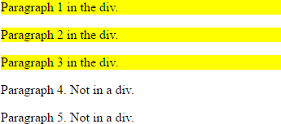
Descendant Selector …
<!DOCTYPE html>
<html>
<head>
<style> div p {
background-color: yellow;
}
</style>
</head>
<body>
<div>
<p>Paragraph 1 in the div.</p>
<p>Paragraph 2 in the div.</p>
<span><p>Paragraph 3 in the div.</p></span>
</div>
<p>Paragraph 4. Not in a div.</p>
<p>Paragraph 5. Not in a div.</p>
<p> elements inside <div> elements
44
</body>
</html>

Slide 45
Child Selector (>)
The child selector selects all elements that are the immediate children of a
specified element.
The following example selects all <p> elements that are immediate children of a
<div> element:
Example
div > p {
background-color: yellow;
}
45

Slide 46
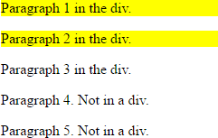
Child Selector …
<!DOCTYPE html>
<html>
<head>
<style> div > p {
background-color: yellow;
}
</style>
</head>
<body>
<div>
<p>Paragraph 1 in the div.</p>
<p>Paragraph 2 in the div.</p>
<span><p>Paragraph 3 in the div.</p></span>
<!-- not Child but Descendant -->
</div>
<p>Paragraph 4. Not in a div.</p>
<p>Paragraph 5. Not in a div.</p>
<p> elements that are immediate children of a <div> element:
</body>
</html>
46

Slide 47
Adjacent Sibling Selector (+)
The adjacent sibling selector selects all elements that are the adjacent siblings
of a specified element.
Sibling elements must have the same parent element, and "adjacent" means "immediately following".
The following example selects all <p> elements that are placed immediately
after <div> elements:
Example
div + p {
background-color: yellow;
}
47

Slide 48
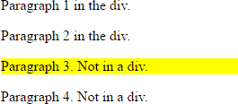
Adjacent Sibling Selector …
<!DOCTYPE html>
<html>
<head>
<style> div + p {
background-color: yellow;
}
</style>
</head>
<body>
<div>
<p>Paragraph 1 in the div.</p>
<p>Paragraph 2 in the div.</p>
</div>
all <p> elements that are placed
immediately after <div> elements
<p>Paragraph 3. Not in a div.</p>
<p>Paragraph 4. Not in a div.</p>
</body>
</html>
48

Slide 49
General Sibling Selector (~ tilde)
The general sibling selector selects all elements that are siblings of a specified
element.
The following example selects all <p> elements that are siblings of <div> elements: Example
div ~ p {
background-color: yellow;
}
49

Slide 50
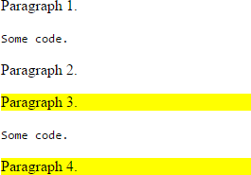
General Sibling Selector …
<!DOCTYPE html>
<html>
<head>
<style> div ~ p {
background-color: yellow;
}
</style>
</head>
<body>
<p>Paragraph 1.</p>
<div>
<code>Some code.</code>
<p>Paragraph 2.</p>
</div>
<p>Paragraph 3.</p>
<code>Some code.</code>
<p>Paragraph 4.</p>
</body>
</html>
50

Slide 51
Define Semantic Elements as Block Elements
HTML5 defines eight new semantic elements.
All these are block-level elements.
To secure correct behavior in older browsers, you can set the CSS display property for these HTML elements to block:
header, section, footer, aside, nav, main, article, figure {
display: block;
}
51

Slide 52
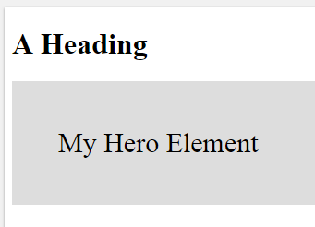
Add New Elements to HTML
This example adds a new element called <myHero> to an HTML page, and defines
a style for it:
<!DOCTYPE html>
<html>
<head>
<script>document.createElement("myHero")</script>
<style>
myHero { display: block;
background-color: #dddddd;
padding: 50px;
font-size: 30px;
}
</style>
</head>
<body>
<h1>A Heading</h1>
<myHero>My Hero Element</myHero>
</body>
</html>
52

Slide 53
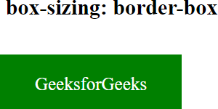
box-sizing: border-box
<html>
<head>
<title>box-sizing Property</title>
<style> div {
width: 200px;
height: 60px;
padding: 20px;
border: 2px solid green;
background: green;
color: white;
}
.border-box {
box-sizing: content-box;
}
</style>
</head>
<body style = "text-align: center;">
<h2>box-sizing: border-box</h2>
<br>
<div class="border- box">GeeksforGeeks</div>
</body> </html>
https://www.geeksforgeeks.org/css-box-sizing-property/
53

Slide 54
CSS Validation
http://jigsaw.w3.org/css-validator/

Slide 55
References
http://www.w3schools.com/css/css_examples.asp
http://www.webcredible.co.uk/
http://stylus-lang.com/
http://oocss.org/spec/css-mixins.html
https://sass-lang.com/
http://lesscss.org/
SAAS –https://www.tutorialspoint.com/sass/
LESS –http://www.tutorialspoint.com/less/

Slide 56
Alternative Styles
<link href="css/default.css" rel="stylesheet" type="text/css" title="Default" />
<link href="css/black.css" rel="alternate stylesheet" type="text/css" title="High Contrast" />
  rel = link-types [CI]
    This attribute describes the relationship from the current document to the anchor specified by the href attribute. The value of this attribute is a space-separated list of link types.
  This specification allows authors to specify a preferred style sheet as well as alternates that target specific users or media.
  User agents should give users the opportunity to select from among alternate style sheets or to switch of off style sheets altogether.

